Slide 1
AI for Nonprofits: A Beginner's Guide"
JANUARY 31, 2025
Angela Garcia, A Gift for Teaching
Notes:
Quick poll: How many people are familiar with AI? Have used AI tools? What tools?

Slide 2

Today's Presentation
MAIN TOPICS
✅ What AI is and why it matters for nonprofits
✅ Real-world nonprofit AI examples
✅ How to start using AI in your organization
Notes:
Objectives of the Presentation
Demystify AI and show its potential for nonprofits.
Share practical, real-world examples of AI in action.
Offer beginner-friendly ways to integrate AI into nonprofit work.

Slide 3
Why AI Matters for Nonprofits
AI can help nonprofits...
  Automate repetitive tasks
  Strengthen fundraising
  Improve donor engagement
  Enhance program impact

Slide 4



Machine Learning
What is AI?
Natural Language Processing
AI ENABLES MACHINES TO LEARN, ANALYZE, AND AUTOMATE TASKS.
Computer Vision
Notes:
Definition: AI (Artificial Intelligence) refers to technology that can perform tasks that typically require human intelligence, such as recognizing patterns, making decisions, and automating repetitive processes.
Types of AI relevant to nonprofits:
Machine Learning (ML): AI that learns from data (e.g., predicting donor behavior).
Natural Language Processing (NLP): AI that understands and processes language (e.g., chatbots, AI-generated content).
Computer Vision: AI that interprets images and videos (e.g., AI-assisted social media analytics).

Slide 5
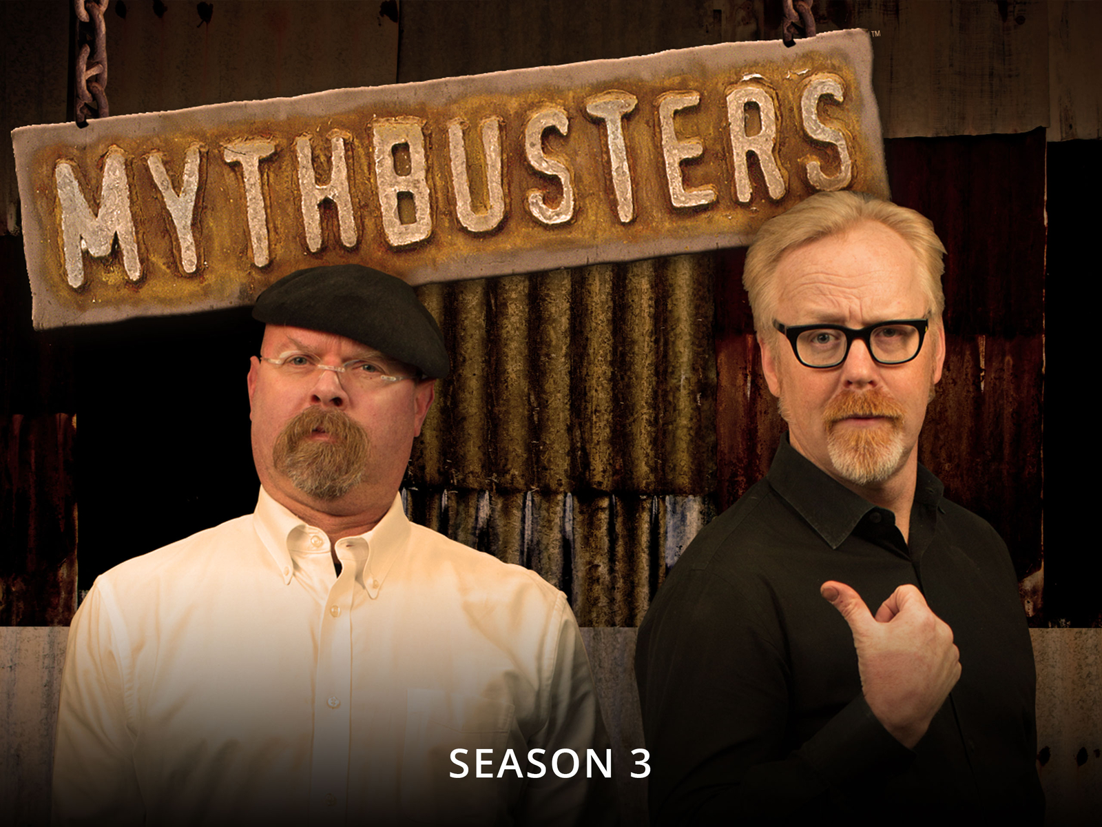

Slide 6
Myth
Myth
Myth
AI is a standalone technology.
AI will replace human workers.
AI is expensive and complex.
Reality
Reality
Reality
AI is used in conjunction with other tech to create COMPRHENSIVE solutions.
AI assists staff, freeing them to focus on impact.
Many AI tools are free or low-cost for nonprofits!
Notes:
"AI is only for big tech companies." → Many AI tools are affordable or even free for nonprofits.
"AI will replace human workers." → AI is a tool to support, not replace, human effort.
"AI is too expensive for small nonprofits." → Many accessible, cost-effective AI solutions exist.

Slide 7
Myth
Myth
Myth
AI is biased and unethical
AI is a recent development.
AI is only used for complex tasks.
Reality
Reality
Reality
Distinguish between the tech itself and implementation.
It’s been around since the 50s and 60s.
Can be applied in every day activities.
Notes:
"AI is biased and unethical." → AI systems can indeed inherit biases from the data they are trained on or the biases of their developers. However, it is important to distinguish between the technology itself and its implementation. AI itself is not inherently biased or unethical. The responsibility lies with the designers, developers, and users of AI systems to ensure ethical considerations are addressed throughout the development and deployment process.
"AI is a recent development.” → While AI has gained significant attention and advancements in recent years, the field has a long history. The foundations of AI can be traced back to the 1950s and 1960s when researchers began exploring the concept of artificial intelligence. Many key concepts and techniques, such as machine learning and neural networks, were developed several decades ago.
"AI is only used for complex tasks.” → AI can certainly handle complex tasks, it can also be applied to more mundane and everyday activities. For example, AI is commonly used in email spam filters, voice assistants, personalized recommendations in online shopping, and even in basic predictive text on our smartphones.

Slide 8

How AI Benefits Nonprofits
Efficiency, Fundraising, Reporting, Marketing

Slide 9
AI for Efficiency
AI for Fundraising
AI-powered chatbots
answering FAQs 24/7
Predictive analytics to identify donors likely to give again
Automated data entry and donation tracking
AI-personalized emails increasing open rates
AI-scheduled emails for
donor engagement
Chatbots providing instant donor support
Notes:
Enhancing Efficiency
AI can automate repetitive tasks, saving staff time and allowing them to focus on high-impact work.
Examples:
AI-powered data entry tools (e.g., scanning and categorizing donation receipts).
Chatbots answering common donor and volunteer inquiries 24/7.
Improving Fundraising & Donor Engagement
AI helps nonprofits understand donor behavior and personalize outreach.
Examples:
Predictive analytics can identify donors likely to give again.
AI-generated personalized email subject lines increase open rates.

Slide 10
AI for Impact
AI for Marketing
AI-powered analysis to gauge program effectiveness
AI-generated captions and blog posts
Automated report generation for grant applications
Automated video subtitles and translations
AI social media tools analyzing engagement trends
AI-powered email subject lines for higher engagement
Notes:
Strengthening Program Impact
AI helps analyze data from programs to measure effectiveness.
Examples:
AI can analyze data
AI can analyze grant applications for alignment with funding priorities.
Boosting Marketing & Communications
AI helps create and optimize marketing campaigns.
Examples:
AI-powered social media tools (e.g., ChatGPT for content creation, Canva’s AI design assistant).
AI-generated video subtitles and translations for broader accessibility.

Slide 11

Charity Water
A NONPROFIT PROVIDING CLEAN DRINKING WATER TO COMMUNITIES WORLDWIDE
Notes:
How They Use AI:
Charity: Water, a nonprofit providing clean drinking water to communities worldwide, uses AI-driven donor engagement tools to personalize communication and improve fundraising.
AI Tool Used:
Rasa (AI-powered chatbot): Automates responses to common donor questions and provides real-time updates on donation impact.
AI-driven email campaigns: Uses AI to analyze donor behavior and personalize outreach, increasing engagement and retention.
Impact:
✅ AI-powered insights led to higher donor retention rates by sending the right message at the right time.
✅ The chatbot reduced staff workload by handling thousands of donor inquiries automatically.

Slide 12

Trevor Project
A NONPROFIT SUPPORTING LGBTQ+ YOUTH IN CRISIS
Notes:
How They Use AI:
The Trevor Project, a nonprofit supporting LGBTQ+ youth in crisis, uses AI to enhance their 24/7 crisis intervention services and help counselors respond more effectively.
AI Tool Used:
Riley (AI-powered chatbot & triage system): Uses Natural Language Processing (NLP) to analyze messages from youth reaching out for support and prioritize high-risk cases.
AI-assisted training: Machine learning helps identify conversation patterns that lead to successful interventions, improving counselor training.
Impact:
✅ AI helps counselors respond faster to high-risk cases, potentially saving more lives.
✅ AI insights enhanced training programs, making crisis response more effective.

Slide 13
Getting Started
Solution for your Needs
Best Practices & Ethics
  Identify your biggest pain point
  Start small with an easy-to-use AI tool
  Test & refine before scaling
  Data privacy & security compliance
  Avoiding AI bias in decision-making
  Transparency with stakeholders
Notes:
AI Tools for Nonprofits
Free & Low-Cost AI Tools
Content Creation & Marketing:
ChatGPT (text-based content, social media captions)
Canva’s AI-powered design suggestions
Grammarly for AI-enhanced writing
Donor & Volunteer Management:
Fundraising AI (e.g., Donorbox AI suggestions)
Chatbots for automated responses (e.g., ManyChat, Drift)
Data Analysis & Reporting:
Google Analytics AI insights
Tableau AI for nonprofit impact reporting
How to Choose the Right AI Solution
Identify Needs: What problem are you solving? (e.g., donor retention, social media engagement)
Start Small: Test one tool before committing to more.
Budget Considerations: Many tools offer nonprofit discounts.
Best Practices & Ethical Considerations
Data Privacy: AI should comply with GDPR and data security standards.
Bias & Fairness: AI learns from data—ensure diverse and unbiased data sets.
Transparency: Be clear with donors and stakeholders about AI usage.

Slide 14

What takes up most of your time?
Notes:
Have people mention in the chat what takes up most of their time.
offer examples of how AI can support.

Slide 15

Take your first step!
✅ Choose one AI tool to test this month
✅ Train your team on AI basics
✅ Keep learning & exploring AI for impact
Notes:
AI is an opportunity, not a threat—it can help nonprofits maximize their impact.
Stay curious and open to experimenting with AI.

Slide 16
Resources
Free Courses
Nonprofit Communities
Google AI, Coursera, TechSoup, Linkedin
Nonprofit Tech For Good, NTEN
Writing & Design Tools
General
Grammarly, Canva, Midjourney, Willy.ai
ChatGPT, CoPilot, Gemini
Notes:
Free AI courses for nonprofits (Google AI, Coursera, TechSoup).
AI communities for nonprofits (Nonprofit Tech for Good, NTEN).

Slide 17

Future Sessions
www.educationalresourcecollective.com/prodev

